Slide 1
Martin Luther King Jr.
Birth:January 15, 1929 Death: April 4, 1968

Slide 2
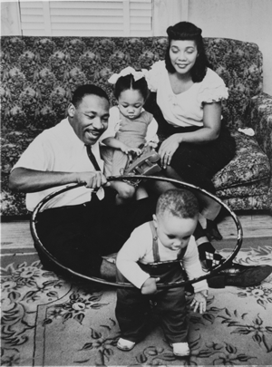
Martin’s family called him “M.L.” He was a very bright boy, and everyone was amazed at what a good memory he had. His parents got him into first grade when he was five, instead of six. But M.L. liked to tell people the truth. When he admitted to the teacher that he was only five, he was told he had to wait another year.

Slide 3
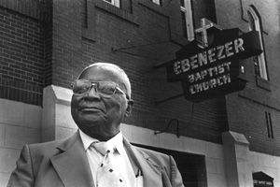
Daddy King was strict, and the three King children had to memorize parts of the Bible and recite them at dinner every day. But M.L.’s grandmother Jennie was very gentle, and she laughed a lot, too. M.L. loved her very much and called her “Mama”. Once, he and his brother A.D. were horsing around, sliding down the banister. They knocked Mama over, and M.L. though they had killed her. He was so upset that he ran to an upstairs window and jumped out, falling 12 feet to the ground. Luckily, he wasn’t hurt. Neither, as it turned out, was Mama.
Martin Luther King Sr.
“Daddy King”

Slide 4
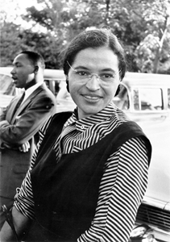
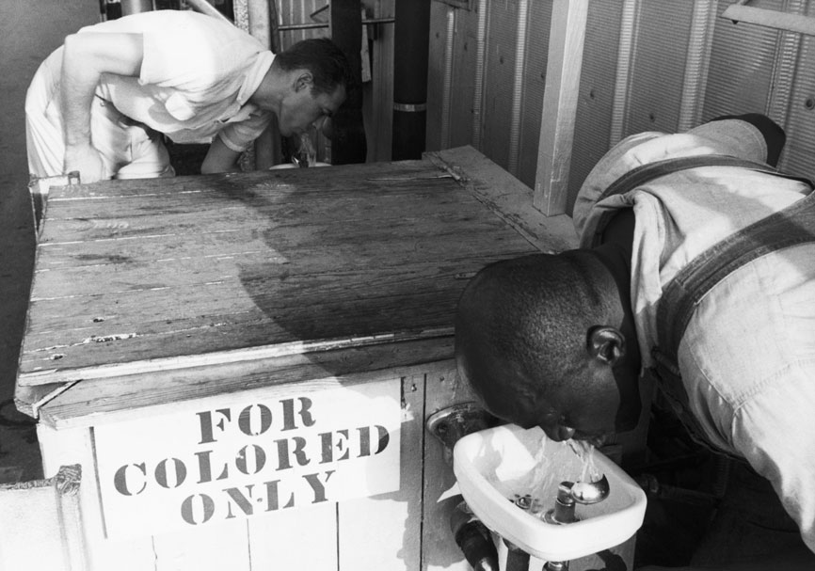
Back when black and white people were segregated, blacks had to sit in the back of the bus– and stand up whenever whites wanted those seats, too. One day, in a full bus, a brave woman named Rosa Parks told the driver she wouldn't give her seat to a white person. The police took her to jail. All the black people in town were so proud of Mrs. Parks that they refused to ride the buses again the law was changed. They asked Martin to speak for them in this struggle to change the law.

Slide 5
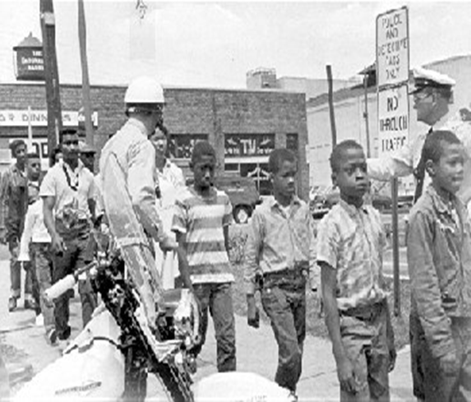
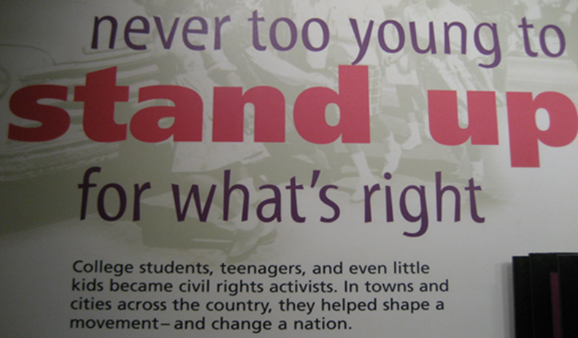
Martin King traveled almost all the time, to help with protest marches in different places. He didn’t get to see his children as often as he wanted to. He didn’t get enough sleep, because there were always new problems. The hardest problem was to keep the marches free from violence. King knew that peaceful marches would change the old laws, and that righting would only slow things down. So he talked to people all over, asking them to stay peaceful.

Slide 6
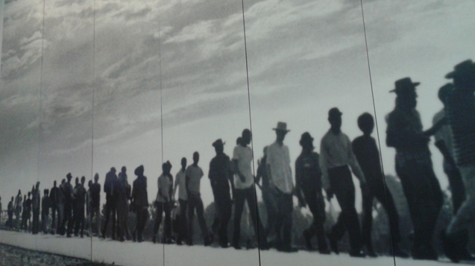
Protest marches often went on for miles, in heat or cold. The people got very tired, but they knew that what they were doing was right. They knew that if they kept going, America would change its old, unfair laws.

Slide 7
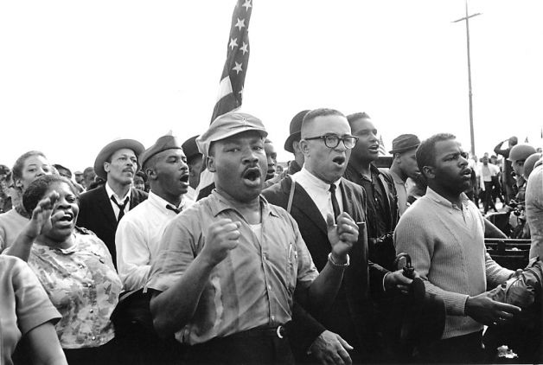
Many marchers sang as they walked. Singing gave them energy and reminded them that they were working together. They made up new songs about rights and freedoms, and soon these songs could be heard all over the country.

Slide 8
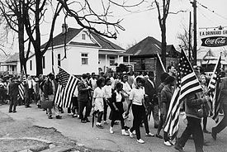
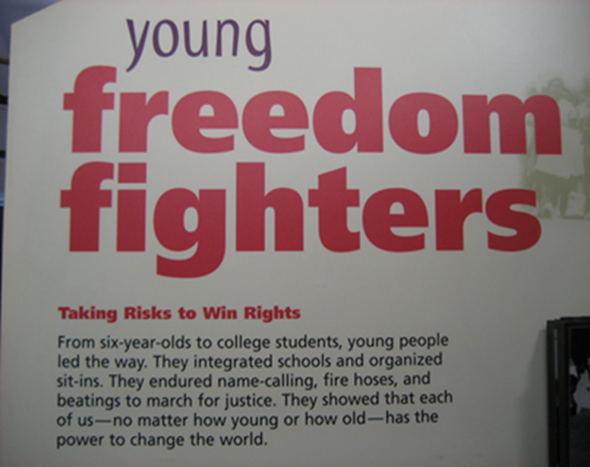
More and more people joined Martin King in protests. They marched through many cities, and often the police got angry. King was arrested fourteen times! Grown-ups weren’t the only ones arrested. Children were put in jail for marching, too. When people around the country saw so many children protesting for civil rights-and getting locked in jail for it-they knew the old laws had to change.

Slide 9
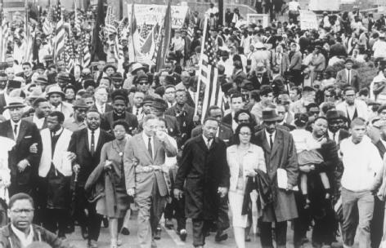
King wanted poor people-both black and white-to get better schools and better jobs. He began asking poor people from all over the country to go to Washington D.C., and stay there, outdoors, until our government finally listened to them. King wanted thousands of people to go there, and to tie up traffic until they got better jobs. People were just starting to go and stay in Washington, when King was killed.

Slide 10
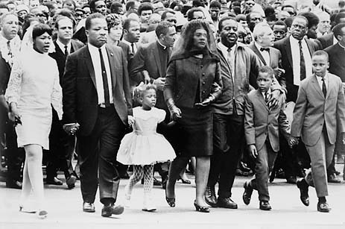
King was killed in Memphis, Tennessee. He was shot by a man who did not want black people to have the same rights as white people. The killer escaped, but soon he was caught and sent to prison. King’s wife, Coretta, and their four children were very, very sad. But they were also brave. They went to Memphis and took Martin’s place, leading a big march.

Slide 11
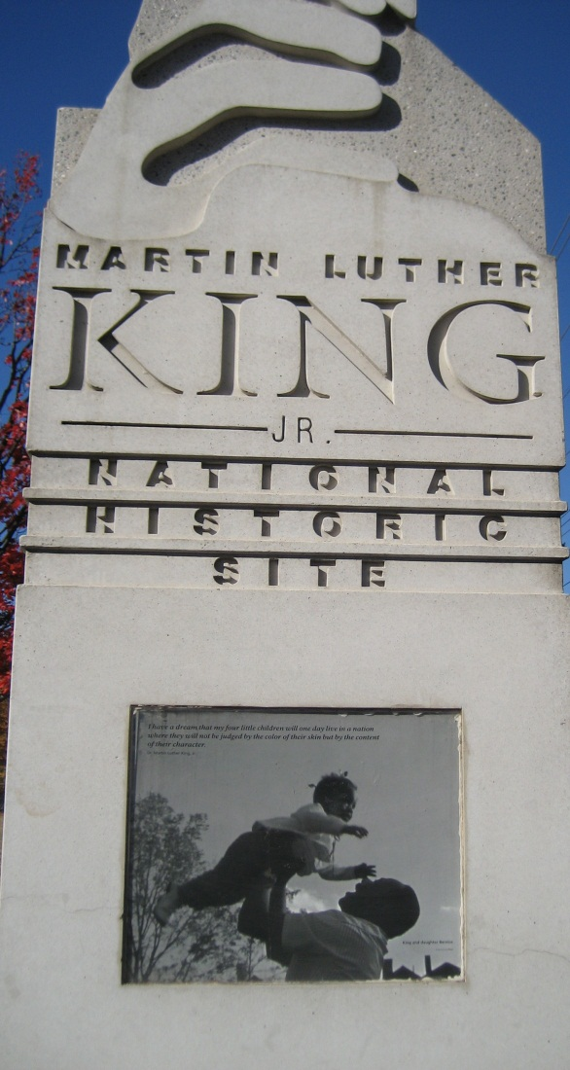
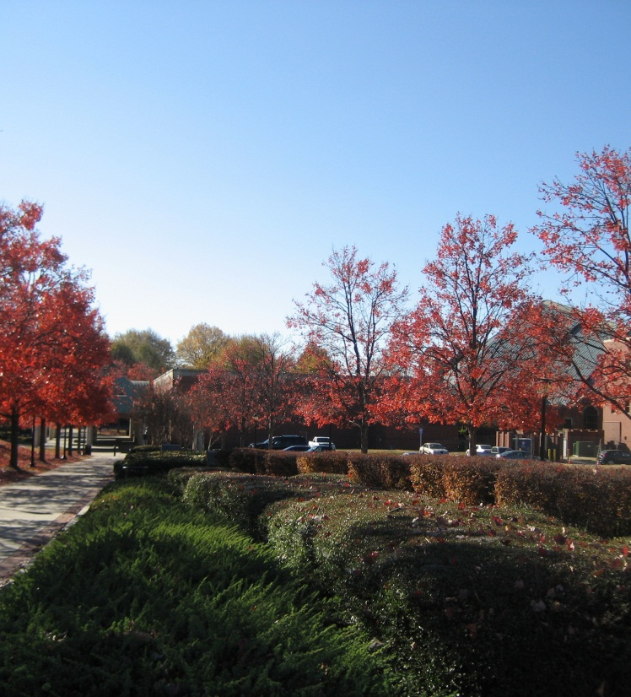
MLK Jr. Museum and Historic Site Atlanta, Georgia

Slide 12
Mural Art in Atlanta showing Martin Luther King’s family

Slide 13
Mural art in Atlanta showing a protest march

Slide 14
Ebenezer Baptist Church Martin Luther King Jr. was the pastor, and so was his dad and grandfather.

Slide 15
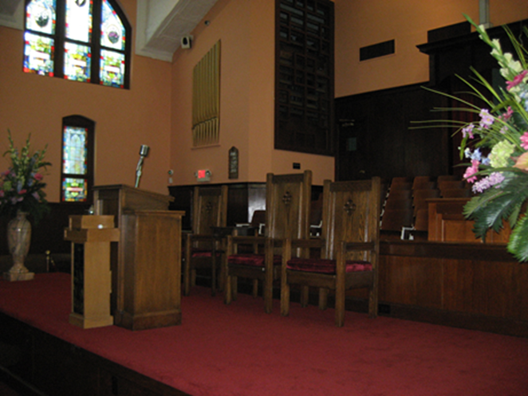
The inside of Ebenezer Baptist Church.

Slide 16
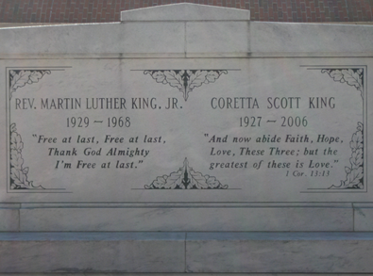
The burial site of Reverend Martin Luther King Jr. and his wife Coretta King.

Slide 17
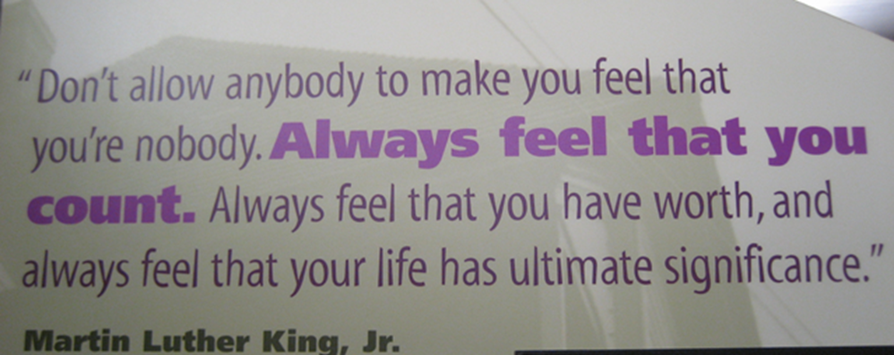
Words of Martin Luther King

Slide 18
Name:
MLK Notes Sheet
MLK was born in ________ and died in __________.
Martin Luther’s family called him __________. M.L. liked to tell people the _____________.
At one time, black and white people were _________________. A brave woman named ______ _______ refused to allow segregation.
Martin King traveled almost all the time, to help with __________ _________ in different places. He knew the biggest problem was to keep the marches free from ________ and stay ______________.
Many marchers __________ as they walked.
___________________ were put in jail for marching, too.
King wanted poor people-both __________ and ___________-to get better _____________ and better _____________.
King was killed in _______________, Tennessee.
Martin was a ___________ of Ebenezer Baptist church, and so was his ____________ and ________________.

